Slide 1
Control – stap 5
@ Bart Bozon

Slide 2

Methods
Thermostat (on/off)
PID
Statespace - observer
LQR controller
Reinforcement learning

Slide 3
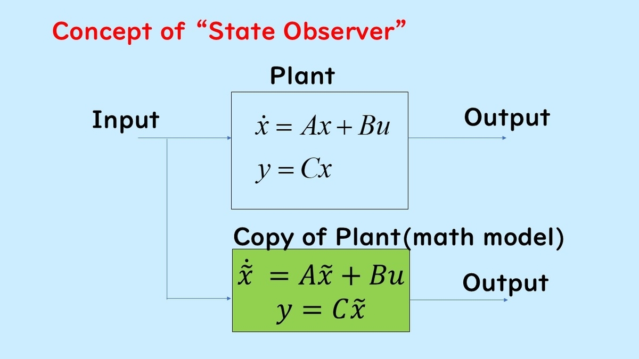
https://blog.control-theory.com/entry/2024/10/01/143305

Slide 4
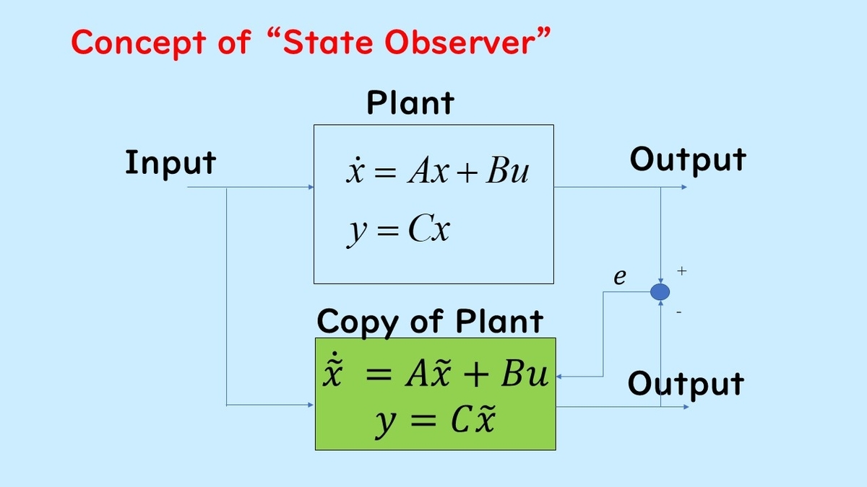

Slide 5
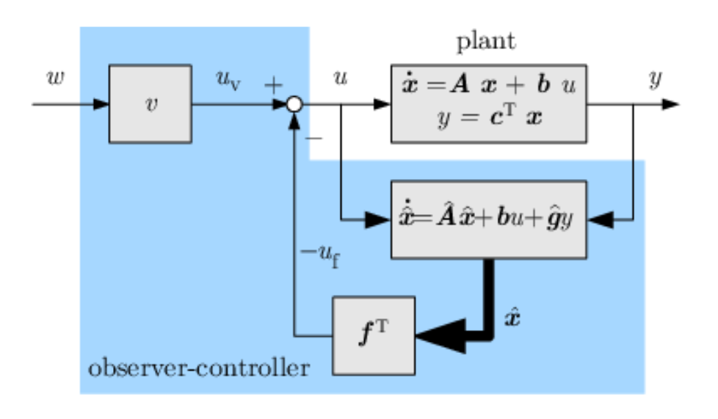
https://mbdcontrolletter.wordpress.com/2016/10/24/what-is-the-concept-of-a-observer-in-control-system-theory/

Slide 6
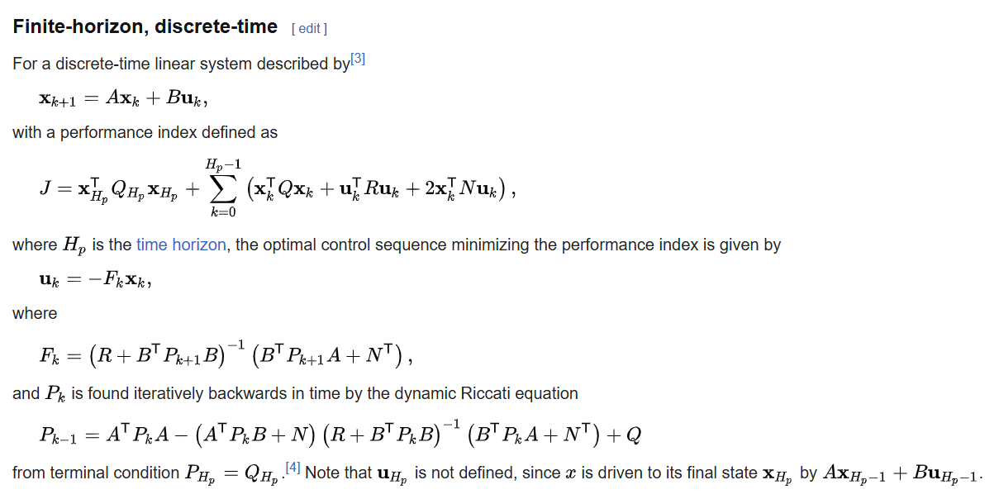
LQR
https://en.wikipedia.org/wiki/Linear%E2%80%93quadratic_regulator

